Slide 1
Eclipse One Stop Portal
August, 2020
TCS – Citi Internal

Slide 2




Why?
Application’s Technical, Functional & Team information is scattered or stored locally with individuals
Risk of losing key information if associate leaves or access is lost
Information is maintained locally into Excel, Notepad or in emails
New Joiner has to contact multiple leads for getting access to required information, causing delayed learning curve
No centralized repository to hold this information
One Stop Portal

Slide 3

Eclipse One Stop Portal – Key Features
One Stop Portal
Project Plan, Task Assignment, Status Tracking
Single Go to place for All Project URLs (++)
Release wise Planview allocation
News Letter maintenance
Project Knowledge Repository
Team Contact Details
Team Leaves Tracking
Team / Individuals Milestone achievement
Easily Configurable
Less Maintenance
Quickly Portable & Easily extendible to other teams
(*) Angular CLI & Micro Service on NodeJs , Platform – PCF Cloud
(++) Marketplace, Service Now, One Reset, Application URLs, Application server details, Jenkins Build, Bit Bucket, Citi Automation Service, JIRA, Confluence, Test Data & Citi Planview

Slide 4

Technology & Infrastructure Details
Angular UI
NodeJs
Excel as DB
PCF Cloud

Slide 5
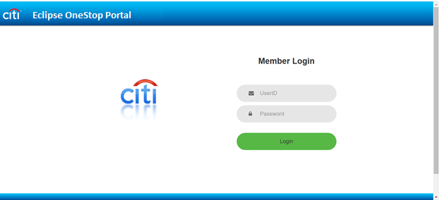
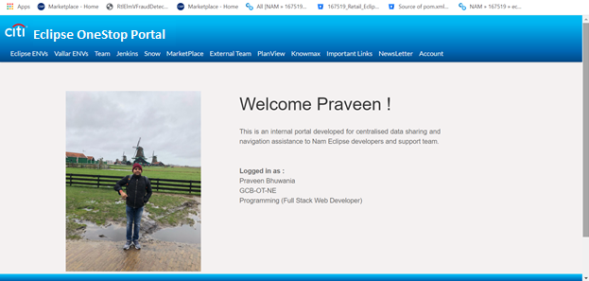
One Stop Portal Screens

Slide 6
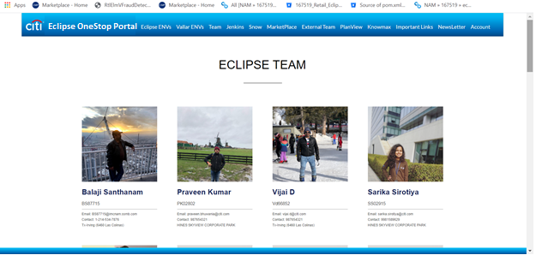
One Stop Portal Screens

Slide 7
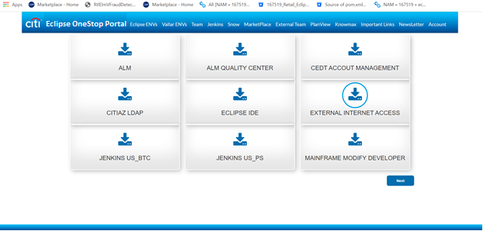
One Stop Portal Screens

Slide 8
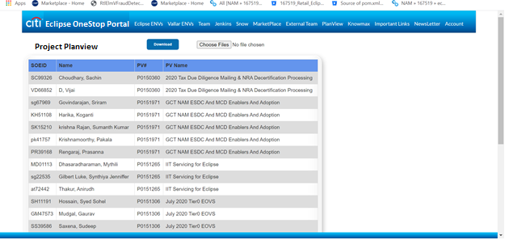
One Stop Portal Screens

Slide 9
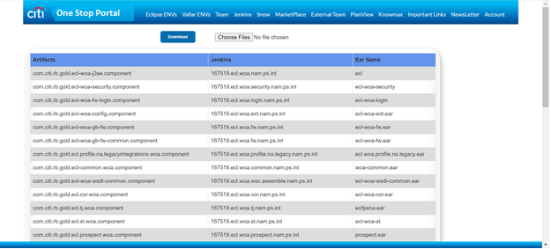
One Stop Portal Screens

Slide 10
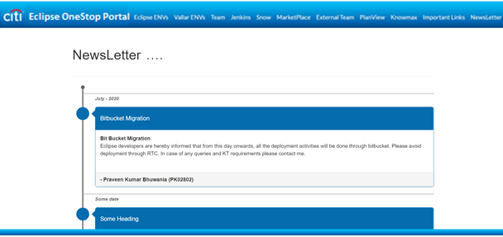
One Stop Portal Screens

Slide 11
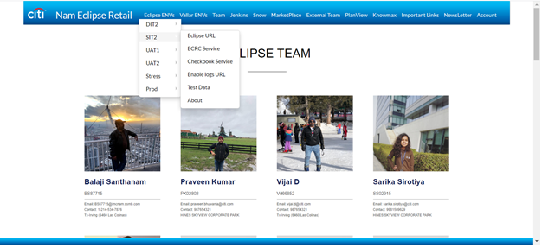
One Stop Portal Screens

Slide 12
Thank You

